Slide 1

INSPIRE
LEADING BY EXAMPLE
INSPIRE

Slide 2
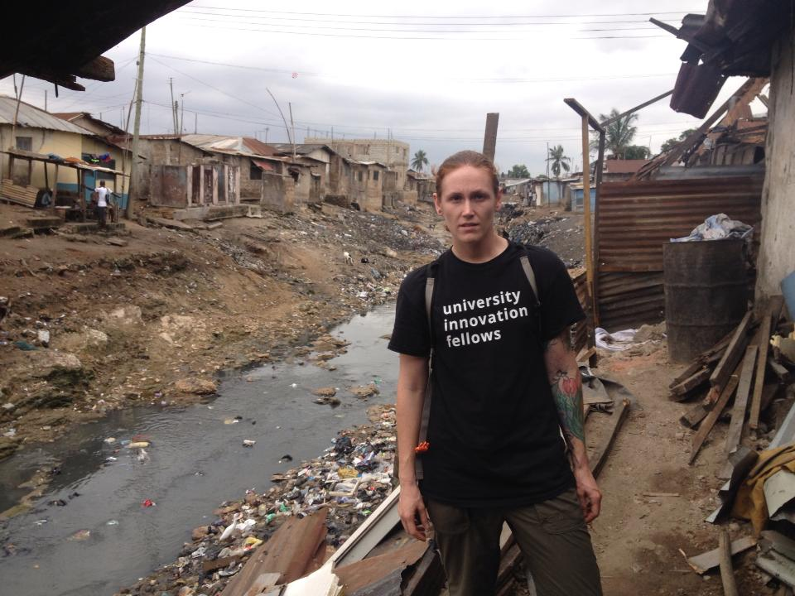

dream
HOME
MAKE A POSITIVE IMPACT ON THE WORLD?
Help people?
AD
VENTURE
LEARN ABOUT OTHER CULTURES?
TRAVEL THE WORLD?
INNOVATION
WHAT DO YOU WANT TO DO?
I
SPEAK A NEW LANGUAGE
DESIGN
S
JOB
CAREER
P
&
I
R
INSPIRE
NTREPRENEURSHIP
CLUB
E
LEADING BY EXAMPLE

Slide 3
WHAT IS INSPIRE?
MISSION:
CULTIVATE STUDENT LEADERSHIP
ENHANCE OPPORTUNITIES FOR UMASS LOWELL, STUDENTS & OUR COMMUNITY
PROMOTE COLLECTIVE GROWTH & SUCCESS
INSPIRE
INDUSTRY
YOU
UMASS LOWELL
COMMUNITY
FURTHER
SUPPORT
CREATE AND DEVELOP MANY
EDUCATE ALL

Slide 4
WHAT IS INSPIRE?
CLUB
VENTURE
BUSINESS
FURTHER SUPPORT
VENTURE A
VENTURE B
VENTURE C
PROTOTYPE
DEVELOP SOLUTIONS
TEACH SKILLS TO SUCESS
IDENTIFY OPPORTUNITIES

Slide 5



WHAT WE WANT TO DO:
INSPIRE:
CREATE & DEVELOP:
GROW:
IDENTIFY PROBLEMS & OPPORTUNITIES
IDENTIFY SOLUTIONS & RESOURCES
FURTHER DEVELOP & PROMOTE COLLECTIVE GROWTH & SUCCESS

Slide 6
ORGANIZATION:
MANAGEMENT & STRATEGY
COMMUNICATIONS
ADMINISTRATION
DESIGN
BUSINESS MODEL
OPERATIONS
FINANCE

Slide 7
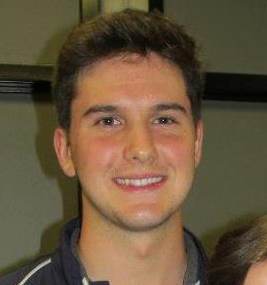
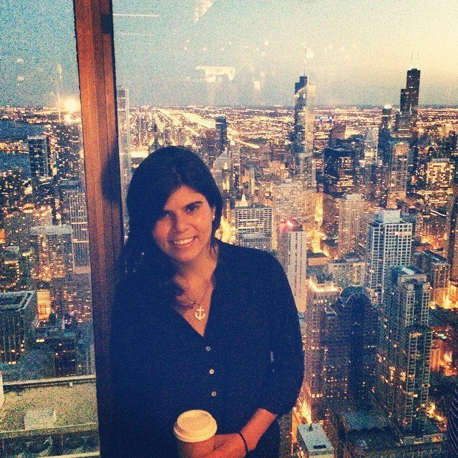
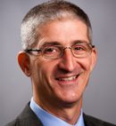
TEAM
CLUB
VENTURE
MANAGEMENT & STRATEGY
KYLE P
PRESIDENT
ANA GOUVEIA
FOUNDER & CEO
KEVIN DESJARDINS
VICE-PRESIDENT
ANDREW MACROBERT
DIRECTOR OF COMMUNICATIONS
COMMUNICATION
ALLY HILL-WHILTON
SECRETARY
PARINAZ
DIRECTOR OF MANAGEMENT
ADMINISTRATION
FARINAZ
DESIGN LEAD
ZACH DURANT
DIRECTOR OF INNOVATION
DESIGN
KURT JENNEY
OPERATIONS LEAD
TOM O’DONNELL
ADVISOR
OPERATIONS
FINANCE
MIKE MCCORMACK
TREASURER
JOSH BUSSOLEIL
CHIEF FINANCIAL OFFICER

Slide 8
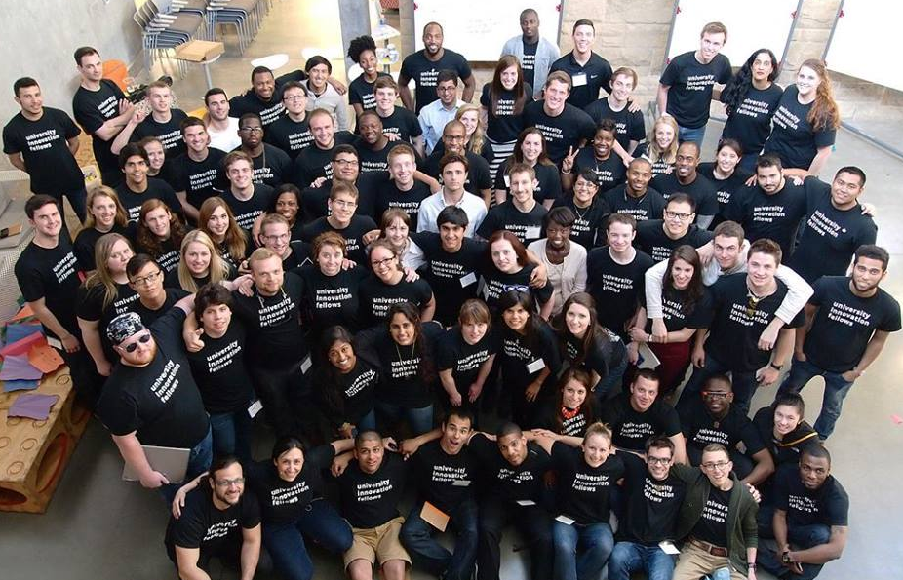
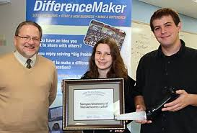
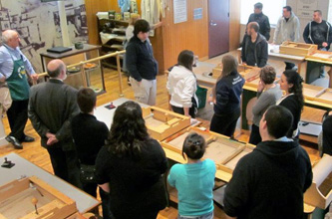

PARTNERSHIPS:
UNIVERSITY INNOVATION FELLOWS
DIFFERENCE MAKERS
SLICE

Slide 9
WHAT IS INNOVATION AND ENTREPRENEURSHIP?
AND WHY SHOULD YOU BE HERE:
SET OF SKILLS NETWORK IDEAS
LEADERSHIP PITCH PATENT
ATTITUDE DESIGN THINKING NEW BUSINESS
PASSION VENTURES CREATIVITY
COLLABORATION TEAM PARTNERSHIP
AMBITION RECRUITING EFFICIENCY
COMMUNICATION MARKETING SUCCESS BOOSTER

Slide 10
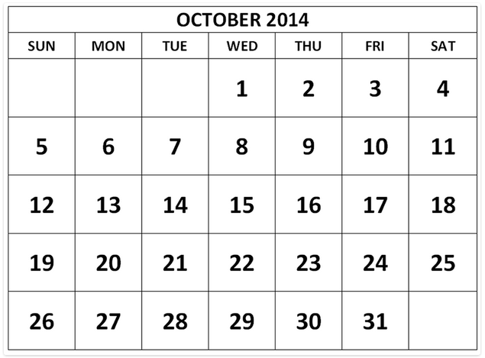
LUNCHTALKS | PANELS & THINK TANK NIGHTS
OPERATIONS
FREE FOOD AND REFRESHMENTS
INTERACTIVE “OUT-OF-THE-BOX”
KNOWLEDGE, SKILLS & OPPORTUNITIES
LECTURES, PRESENTATIONS & PANELS
LEADERSHIP
BRAINSTORMING SESSIONS
DESIGN THINKING
PROJECTS DEVELOPMENT
WEDNESDAYS
PASTEUR 405
6:30-8:00 PM
LUNCHTALKS
PANEL NIGHT
THINK TANK NIGHT

Slide 11

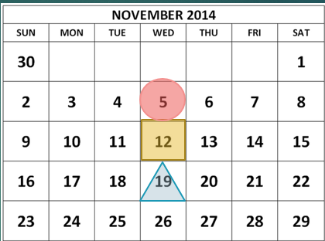
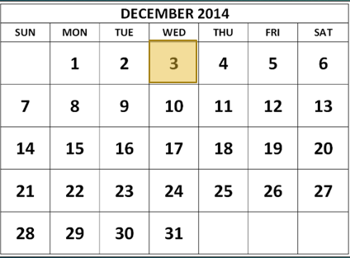
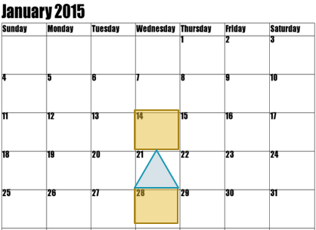

LUNCHTALKS | PANELS & THINK TANK NIGHTS
EDUCATION + CULTIVATING IDEAS
PROJECT DEVELOPMENT
CREATING SOLUTIONS
PROTOTYPING
ESTABLISHING VENTURES
LUNCHTALKS
PANEL NIGHT
OWN SPACE? INCUBATOR!
THINK TANK NIGHTS

Slide 12
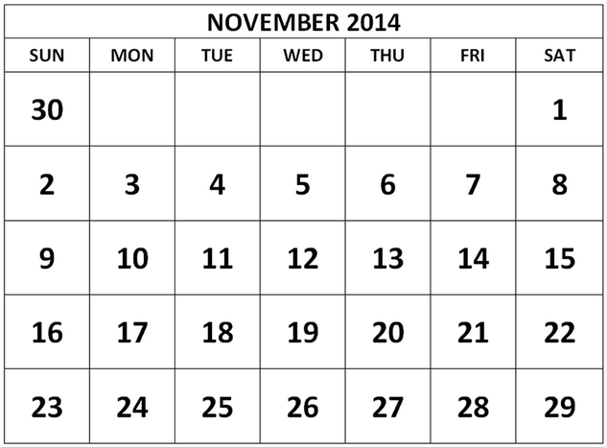
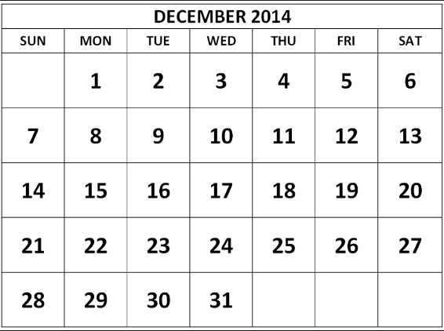

LUNCHTALKS | PANELS & THINK TANK NIGHTS
LUNCHTALKS
PANEL NIGHT
THINK TANK NIGHTS

Slide 13



LUNCHTALKS SCHEDULE
FUTURE OF STRUCTURAL ENGINEERING
PRESENTATION BY DON DUSENBERG
FORMING TEAMS
LEADERSHIP
NETWORKING
COMMUNICATION
BRAINSTORM
FROM IDEAS TO SOLUTIONS
PITCH
MEET THE TEAM
PARTNERSHIPS
RESOURCES
PANEL OF YOUNG ENTREPRENEURS
PANEL OF SUCCESSFUL WOMEN
WED 17
WED 17
OCT 17
WED 17
WED 17
WED 17
DECEMBER
OCTOBER
EXCEL
SETTING GOALS
BUDGETTING
STRATEGIC THINKING
CREATING AN APP
POLLING IDEAS
DESIGN
FUTURE OF STRUCTURAL ENGINEERING
PRESENTATION BY DON DUSENBERG
PANEL OF YOUNG ENTREPRENEURS
PANEL OF SUCCESSFUL WOMEN
MEET THE TEAM
PARTNERSHIPS
RESOURCES
OCT 17
WED 17
WED 17
WED 17
WED 17
WED 17
NOVEMBER
DECEMBER

Slide 14
dream
WHAT DO YOU WANT TO DO?
INNOVATION
I
DESIGN
S
P
&
I
R
INSPIRE
NTREPRENEURSHIP
CLUB
E
LEADING BY EXAMPLE

Slide 15
dream
WHAT DO YOU WANT TO DO?
INNOVATION
I
DESIGN
S
P
&
I
R
INSPIRE
NTREPRENEURSHIP
CLUB
E
LEADING BY EXAMPLE

Slide 16

dream
HOME
MAKE A POSITIVE IMPACT ON THE WORLD?
Help people?
AD
VENTURE
LEARN ABOUT OTHER CULTURES?
TRAVEL THE WORLD?
INNOVATION
WHAT DO YOU WANT TO DO?
I
SPEAK A NEW LANGUAGE
DESIGN
S
JOB
CAREER
P
&
I
INSPIRE
R
NTREPRENEURSHIP
CLUB
E
LEADING BY EXAMPLE

Slide 17
LUNCHTALKS | PANELS & THINK TANK NIGHTS
OPERATIONS
FREE FOOD AND REFRESHMENTS
INTERACTIVE “OUT-OF-THE-BOX”
KNOWLEDGE, SKILLS & OPPORTUNITIES
WEDNESDAYS ROOMS TBD
LECTURES, PRESENTATIONS & PANELS
LEADERSHIP
BRAINSTORMING SESSIONS
DESIGN THINKING
PROJECTS DEVELOPMENT
LUNCHTALKS
12PM-1PM
PANELS & THINK TANK NIGHTS:
6:30-8:00 PM

